Slide 1

Bsides Spl²² The Holistic Approach to Data Integration with Splunk Enterprise

Slide 2


HI!
I’m
Giuseppe Cusello

Slide 3


I’m Giuseppe Cusello from Italy
I live near Rome in front of seaside.
I'm a sixtytwo years old Engineer with more than thirty years of job experience
I am a GRC Consultant and an Auditor
Splunk changed my career eleven years ago.
Now I'm a Splunk Architect and I work almost full time on Splunk and Enterprise Security
I am a Splunk Trust and I am the coordinator of the "Roma Splunk User Group"
I love to participate to Splunk Community
Notes:
Image downloaded from https://www.pngall.com/comic-png/download/59539

Slide 4

The holistic approach to data integration with Splunk
GRC is a crazy land of multiple, heterogenous, non-integrated and for geek-only tools. Have you ever tried to have a quantitative and unified view about your Risk Posture? Do you remember the ginormous excels, reports and table you were pulling together?
Using Splunk, we used a different approach: take multiple outputs of heterogeneous tools and systems (e.g.: Asset Management, VA, APM, Taxonomy, BC, Risk Quantification, etc.) and correlate them to allow easy navigation leveraging the unparalleled capabilities of Splunk Data to Everything platform.
We engineered data integration and specialized views for executive risk managers and geeks aligned with the main frameworks (NIST, ISO27K, GDPR) delivering a quantitative view of your GRC world.

Slide 5
The challenge
Obtain 360° visibility on the interactions between business processes and technological assets.
Correlate information on different levels of risk evaluation carried out (IT assets, IT applications, Business Continuity), that impact the Value Chain, accessible to the Key People involved in risk management processes (Risks Management, Compliance, IT Security, etc.)

Slide 6
The problem
All the monitoring systems have their own console and operators have to continously switch
All the monitoring systems have dashboards for operators and analysts and never for managers and executives
Data can be different or similar and they come from etherogeneous systems (e.g. risk quantification)

Slide 7
The context
CLUSIT 2020 report on ICT security in Italy:
"by 2025, 25% of spending on security services will be allocated to the implementation and maintenance of a trust framework where, in addition to IT Security, it will be necessary to adopt a strategy that provides for organizational interventions in able to transform processes and manage change, in a context dominated by a high interdependence between functions and organizations "
Gartner:
by 2023, third-party functionality orchestration will be listed as a critical requirement in more than 75% of Request For Proposals related to fraud detection systems, which is an increase from less than 25% today.

Slide 8
The market requests (1/2)
Large Enterprise Customers need to bring together information on the status and level of maturity of IT processes and infrastructures from the various company areas
There is a great “distance” between the operational areas (IT, IT Security, Software Development, etc.) and the Governance, Risk Management and Internal Audit areas.
The amount of information and complexity and articulation of the integration processes grow with the growth of the company
The evaluations and surveys of the indicators require time and resources, constituting a growing expense item as the size of the company and the need to adapt to standards and regulations grow.

Slide 9
The market requests (2/2)
The main difficulty is represented by the amount of heterogeneous information to calculate the performance and risk indicators,
This information is processed by different areas with different methods
IT Ops have the difficulty of providing summary data for evaluating the IT infrastructures to the Compliance and Risk Management areas in compliance with what is requested
This complex process often runs into limited budgets and resources

Slide 10
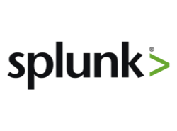

The solution; An environment to perform:
Data ingestion, normalization and indexing
Data Correlation
Dashboards for all levels of users
Machine Learning algorithms and statistical inference techniques such as Cluster Analysis to increase the ability to identify trends and anomalous situations.

Slide 11




Conclusions
Splunk with HOLOS represent a natural evolution of the digital modernization process and becomes an integrated system to promote knowledge to the decision-makers of the client company.
reduces the 'distance' between the Operation areas and the Governance and Risk Management areas
increases the confidence in the construction of the KPIs and KRIs necessary to be able to decide the investment strategies for the mitigation of Operational Risk.
innovative means of making available information normally distributed between the various business areas, allowing analysis and monitoring of the posture of IT infrastructures based on objective data
Result
Savings in terms of dedicated resources and time to obtain information

Slide 12








Idea
Requisites
Customers
Design
Development
Modeling
Analysis
The Idea Evolution
Development of the modules using Splunk Enterprise
Technical design of the solution
Modules design
Dashboard design
Identification of customers with requirements solvable with Holos
Model definition
Conceptual design
Problem analysys
Solution global design
Requisites definition
A pressing need on the part of some customers
Willingness to create a niche product that meets these needs
Notes:
Image downloaded from https://www.pngall.com/comic-png/download/59491

Slide 13
Principles
Idea
Requisites
Customers
Design
Development
Modeling
Analysis
In addition to constituting operational tools for the technical areas and anti-fraud teams, all HOLOS components will have to contribute to the formation of a Decision Support Platform for management
Focus on Primary Business Processes, with the idea of creating a Governance system capable of giving a 360 ° view of how much IT systems contribute to mitigating the Operational Risk ... or how much they raise it!
360 ° view of the contribution and criticalities that IT systems guarantee to the Primary Business Processes:
Highlighting of Processes subject to Business Continuity
IT applications subject to Risk Evaluation that support the Processes
Assessment of the posture with respect to vulnerabilities on IT Assets that support Applications
View of compliance with regulations or reference standards in terms of Maturity Evaluation

Slide 14


Idea
Requisites
Customers
Design
Development
Modeling
Analysis
Requisites
Implement continuous monitoring of business posture and the level of maturity of IT systems
Provide a tool for the continuous assessment of the IT risk of corporate structures and external suppliers
Provide tools for convergence between adopted standards and regulatory requirements (e.g. ISO 27001 and NIS regulations)
Mitigate the gap between the assessments carried out by the corporate areas dedicated to Compliance and those of Cyber Security and IT Security

Slide 15
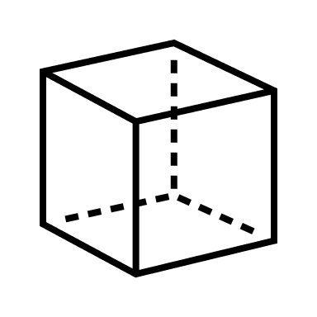
Idea
Requisites
Customers
Design
Development
Modeling
Analysis
Goals
Collecting and correlating key information related to different types of risk (Cyber, IT, business continuity and regulatory)
Enriching the model with information related to business processes, application portfolio and IT resources
By monitoring and tracing the evolution of corporate Cyber posture and maturity to link the controls applied by different standards
By consolidating the information collected in a centralized repository to allow comparison over time

Slide 16







Idea
Requisites
Customers
Design
Development
Modeling
Analysis
Information Flow
Data Source
Decision Support System
Evaluation of safety measures
Technical configurations
Company CMDB
Standard evaluation
Data Platform
It is the single repository for the
• storage,
• the update
• reporting
aimed at all organizational levels, to quickly support them in their choices for the protection and defense of corporate assets
It is possible to obtain results from analyzes and investigations, thanks to advanced Data Analytics features.
Able to unify and correlate risk assessments, collected through specific and automatable connectors

Slide 17
Advantages for the customer
Idea
Requisites
Customers
Design
Development
Modeling
Analysis
reduction of information collection time for the establishment of risk indicators;
increase in confidence in the summary data produced, generated directly and not through different passages between different company areas;
the availability of comparable data over time and in any case re-evaluable in the event of changes in the complex aggregation methods;
the reduction of the efforts necessary to supervise the evaluation and control processes;
the availability of a system capable of supporting managerial decisions.

Slide 18
Advantages for the developers: a platform
Idea
Requisites
Customers
Design
Development
Modeling
Analysis
with ready-to-use ingestion features (input, parsing, indexing)
with ready –to-use normalization structure
with pre imposted data correlation mechanism
with many dashboards available as-is and/or customizable

Slide 19
The value chain
Idea
Requisites
Customers
Design
Development
Modeling
Analysis
A common point of use of information
Information on the specific context (e.g.: anti-fraud), but also the process economic values (e.g.: frauds avoided and savings)
The enabling factor are Big Data Ingestion and Analytics, Machine Learning and Information Clustering
This approach becomes an alternative to DataWarehousing techniques
Notes:
d) Innovative value proposition
Describe the elements of value (eg tangible and / or intangible) that are proposed to the customer, such as
particular use experience, innovation, economy, accessibility.
 Why should customers choose your product / service, what benefits could it offer?
 Why do you consider your proposal innovative?
 Compared to the solutions currently in use in the reference market / sector, why does your product / service take on an improvement or replacement character?
 What are the competitive advantages, strengths and weaknesses and characteristics of the product / service compared to those of the competition?
Max 4000 characters
This approach within client organizations allows to obtain a common point of use for information relating to the posture of IT systems, risk assessments of IT assets, IT applications supporting business processes, assessments on the criticality of the latter. and therefore the recovery requirements in the event of a service interruption to ensure the operational continuity of the business.
The verticalizations make it possible to collect and make available information relating to the specific context under analysis (eg anti-fraud), but also to be able to set the economic values ​​relating to the specific process (eg identify the frauds avoided and the savings made).
This information is typically distributed and present in the operational areas that have ownership of it, which then have the responsibility of synthesizing, packaging and sending it to control areas such as those of Governance and Risk Management.
The novelty therefore consists in bringing the information database coming from the collection of events and results from the business IT systems and from the technological systems of evaluation, control and fight against fraud, etc. in the availability of those who manage the operation of the systems, of those who govern the processes and regulate the procedures, of those who assess the exposure to risk in order to determine the risk appetite in corporate strategies at the level of the Board.
The enabling factor of the system is given by the components of Big Data Ingestion and Analytics, Machine Learning and Clustering which constitute its heart and which offer advanced techniques for identifying the elements useful for evaluating the phenomena actually taking place in the company with the greatest possible confidence.
This technological approach to the problem of the availability of real data on which to build the syntheses and indicators that support strategic business decisions becomes an alternative to DataWarehousing techniques that have been considered the only viable way since the early 80s. However, these systems suffer from slowness in retrieving updated data, require a preventive design of the database, and therefore a transformation of the data, which does not allow the flexibility necessary to keep up with the continuous evolutionary changes of the application park now necessary to respond to the market pressures in terms of competitiveness.
This approach represents a natural evolution of the digital modernization process and becomes an integrated system to promote knowledge to the decision-makers of the client company.
d) Innovative value proposition
Describe the elements of value (eg tangible and / or intangible) that are proposed to the customer, such as
particular use experience, innovation, economy, accessibility.
 Why should customers choose your product / service, what benefits could it offer?
 Why do you consider your proposal innovative?
 Compared to the solutions currently in use in the reference market / sector, why does your product / service take on an improvement or replacement character?
 What are the competitive advantages, strengths and weaknesses and characteristics of the product / service compared to those of the competition?
Max 4000 characters
This approach within client organizations allows to obtain a common point of use for information relating to the posture of IT systems, risk assessments of IT assets, IT applications supporting business processes, assessments on the criticality of the latter. and therefore the recovery requirements in the event of a service interruption to ensure the operational continuity of the business.
The verticalizations make it possible to collect and make available information relating to the specific context under analysis (eg anti-fraud), but also to be able to set the economic values ​​relating to the specific process (eg identify the frauds avoided and the savings made).
This information is typically distributed and present in the operational areas that have ownership of it, which then have the responsibility of synthesizing, packaging and sending it to control areas such as those of Governance and Risk Management.
The novelty therefore consists in bringing the information database coming from the collection of events and results from the business IT systems and from the technological systems of evaluation, control and fight against fraud, etc. in the availability of those who manage the operation of the systems, of those who govern the processes and regulate the procedures, of those who assess the exposure to risk in order to determine the risk appetite in corporate strategies at the level of the Board.
The enabling factor of the system is given by the components of Big Data Ingestion and Analytics, Machine Learning and Clustering which constitute its heart and which offer advanced techniques for identifying the elements useful for evaluating the phenomena actually taking place in the company with the greatest possible confidence.
This technological approach to the problem of the availability of real data on which to build the syntheses and indicators that support strategic business decisions becomes an alternative to DataWarehousing techniques that have been considered the only viable way since the early 80s. However, these systems suffer from slowness in retrieving updated data, require a preventive design of the database, and therefore a transformation of the data, which does not allow the flexibility necessary to keep up with the continuous evolutionary changes of the application park now necessary to respond to the market pressures in terms of competitiveness.
This approach represents a natural evolution of the digital modernization process and becomes an integrated system to promote knowledge to the decision-makers of the client company.

Slide 20
Idea
Requisites
Customers
Design
Development
Modeling
Analysis
The logical model
Business Continuity
Risk Score
Primary Business Processes
Fraud
Risk Score
IT application infrastructure
IT Assets
Fraud Management systems
Vulnerability Assessment
Risk Score
IT Applications
Mobile Management systems
Data Classification
Risk Score
Categorie di Dati
PenTest
Risk Score
IT Risk Management
Human Factor
Analisys
IT processes & infrastructure
Attack Surface
Maturity Evaluation

Slide 21
The first verticalizations
Idea
Requisites
Customers
Design
Development
Modeling
Analysis
Anti Fraud monitoring
Mobile Security (M3)
Security Asset Management
System Administrators Compliance (Italian Data Protection Authority regulation)
Banking transparency (Italian Data Protection Authority regulation)
Risk Hub
IT Asset Deep Information Manager
PNSC (Italian National Plan for Cyber Protection and Information Security

Slide 22









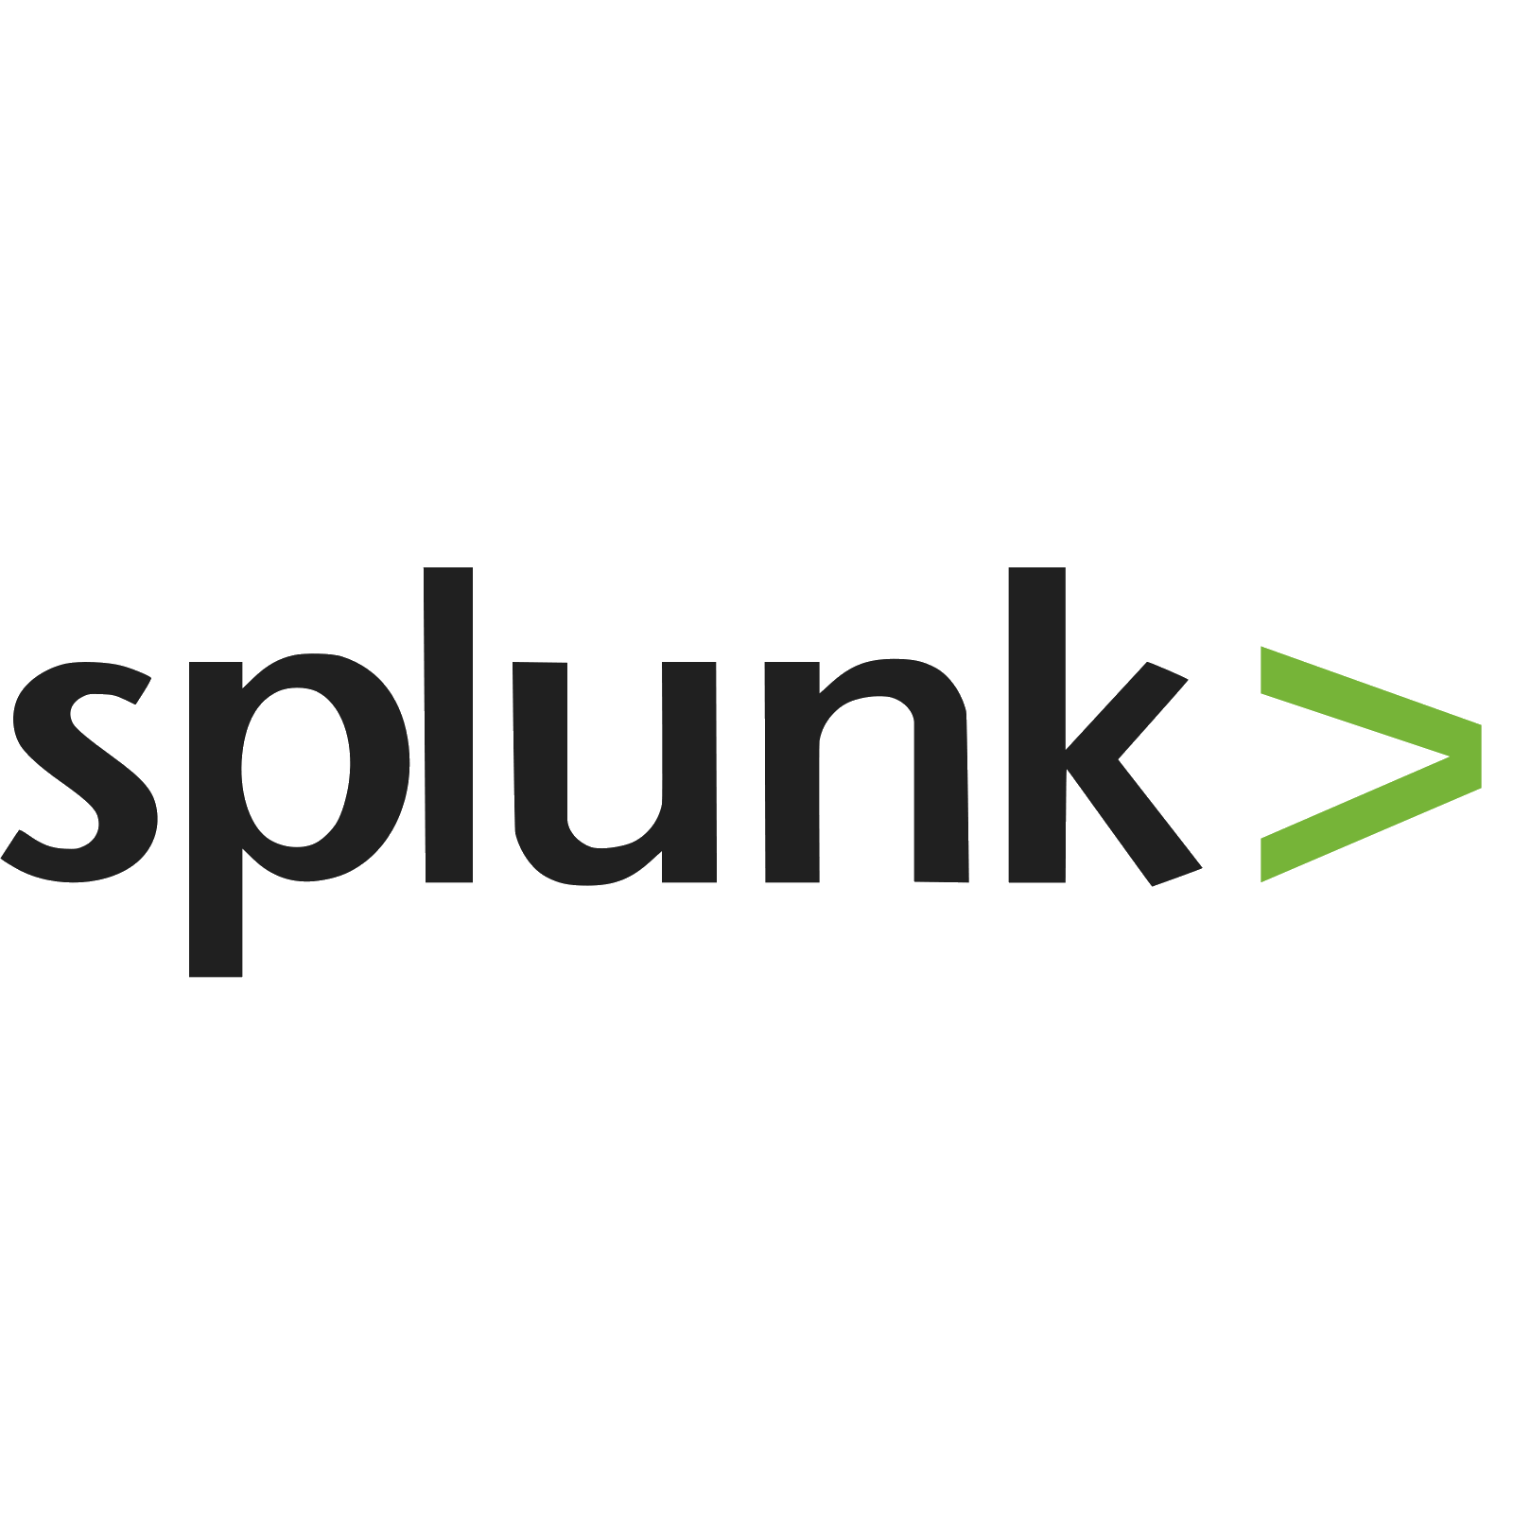



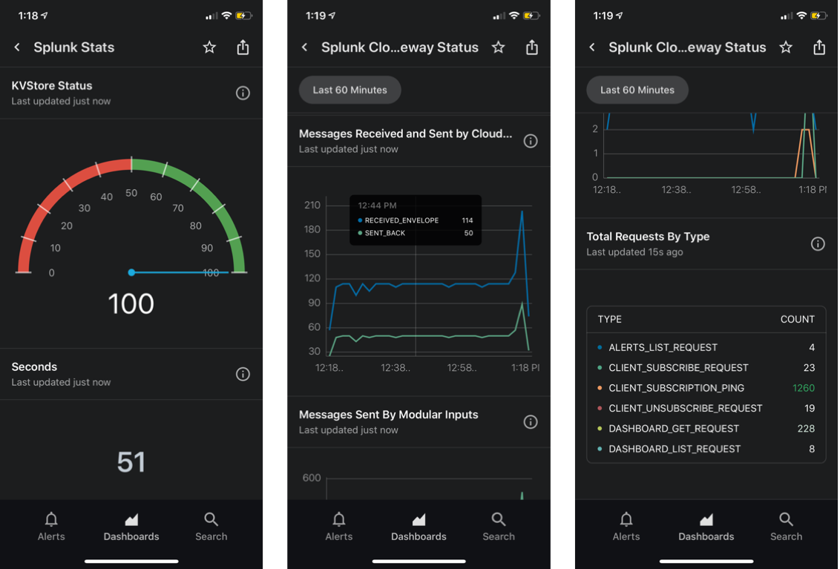
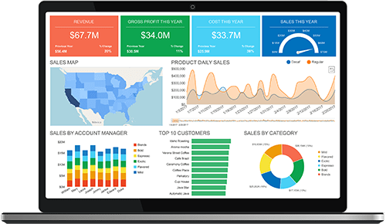
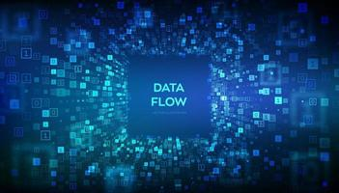
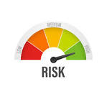

Idea
Requisites
Customers
Design
Development
Modeling
Analysis
Architecture
Threat
Intelligence
App
Integrations
Add-On
Modular structure
Inputs
Parsing
Normalization
Machine Learning
Mobile Access
Indexing
Enrichment
Dashboarding
Dashboards
Case Man.
Navigation
3° parties:
SOARs
SIEMs
TIPs
Correlation
Data Quality Analysis

Slide 23

Add-Ons & dATA sources
Idea
Requisites
Customers
Design
Development
Modeling
Analysis
Standard TAs:
Tenable, Qualys, VAs
Office365,
Digital Shadows,
ServiceNow,
Etc…
Custom TAs for specific environments:
MasterCard Cyber Quant,
Tenable risk,
Etc…
Customers’ custom data inputs:
Process Taxonomy,
CMDB,
SNOW,
Application Portfolio Management,
Risk Analysis systems,
Etc…
Splunk Enterprise Security:
Assets Risk Scores

Slide 24












External Security Information Services
Idea
Requisites
Customers
Design
Development
Modeling
Analysis
Threat
Intelligence

Slide 25
Data Updates
Idea
Requisites
Customers
Design
Development
Modeling
Analysis
The problem:
Normal updates are usually done downloading the entire archive with different frequencies between the flows
There’s the problem to always find the last update version
The solution we implemented in Splunk:
A macro that always extract the last version of an update not depending on the update frequency

Slide 26
Data Updates: the solution
Idea
Requisites
Customers
Design
Development
Modeling
Analysis
cp_sam($eventtype$)
eventtype="$eventtype$" [ | metasearch eventtype="$eventtype$" latest=now | head 1 | eval earliest=relative_time(_time,"-1h"), latest=relative_time(_time,"1h") | fields earliest latest ]
Live Demo

Slide 27
Data Normalization (1/2)
Idea
Requisites
Customers
Design
Development
Modeling
Analysis
Define a Record Layout (field names) for each Holos archive
Analyze the information of each new Data Flows
Define, on paper, the field renames, to align the new Data Flows to the Holos Record Layout, e.g.:
CD_ASSET ASNEW asset_code
CD_ASSET_INCORPORATING ASNEW incorporating_asset_code
ABI ASNEW abi_code

Slide 28
Data Normalization (2/2)
Idea
Requisites
Customers
Design
Development
Modeling
Analysis
Define on paper the field transformations, to align the new Data Flows to the Holos Record Layout, e.g.:
<o365_comp> AssessmentStandard=if(AssessmentStandard="ISO/IEC 27001","ISO27001:2013",AssessmentStandard)
<tenable:sc:vuln> AssessmentStandard=case(match(xref,"ISO\/IEC-27001"),"ISO/IEC 27001", match(xref,"GDPR"),"GDPR", match(xref,"800-53"),"NIST 800-53", match(xref,"CSF"),"NIST CSF")
<tenable:sc:vuln> Control=coalesce(Control, ISO27001_Control)
Apply renames and transformations in the Holos App
Live Demo

Slide 29
Correlations: activities
Idea
Requisites
Customers
Design
Development
Modeling
Analysis
Analyze the information of each Data Flows
Define the correlation keys, drawing the Entity-Relationship diagram
Identify the situations where it could be useful to create a table correlating the data Flows
Create tables correlating the data Flows
Use the correlation keys in searches
Live Demo

Slide 30
Idea
Requisites
Customers
Design
Development
Modeling
Analysis
Entity / Relationship
CMDB
(e.g. Security
Asset Management)
apm_asset_code
BC
apm_asset_code
process-code
phase_code
APM
IT_RISK
Asset_code
TAXONOMY
apm_asset_code
apm_asset_code
process-code
phase_code

Slide 31
Whitelisting: the problem
Idea
Requisites
Customers
Design
Development
Modeling
Analysis
In data correlation checks, there could be false positives:
data that haven’t correlations
data that doesn’t have to be highlighted in checks,
in other words how to avoid false positives in data correlation checks and maintain these informaton for the nexts checks?
Splunk isn’t a DB and it isn’t possible to modify data stored

Slide 32
Whitelisting: the solution
Idea
Requisites
Customers
Design
Development
Modeling
Analysis
Some lookups (KV-Store) contaiing the whitelists to not check:
Taxonomy,
BC
Some dashboards:
containing all the errors that emerged during the check
The possibility to flag each error message
And a Javascript that updates the lookup

Slide 33
As everything in
70%
30%
Idea
Requisites
Customers
Design
Development
Modeling
Analysis
Development
100%
Job
What to know
Realization
Notes:
Image downloaded from https://www.pngall.com/comic-png/download/59491

Slide 34
What to know (on paper)
Idea
Requisites
Customers
Design
Development
Modeling
Analysis
Identify Requirements (Use Cases)
Identify Data Sources
Analyze Data
Identify Normalizations
Identify Correlations
Define Outputs (dashboards, Reports, Alerts)
Define Navigation Rules (menu, links between dashboards, drilldown

Slide 35
Realization (on Splunk)
Idea
Requisites
Customers
Design
Development
Modeling
Analysis
Set up inputs
Create Normalizations
Create Correlations
Customize Dashboards, Reports and Alerts
Customize Navigation (menu, links between dashboards, drilldown
Live Demo

Slide 36


Idea
Requisites
Customers
Design
Development
Modeling
Analysis
Modules
Fraud
Security Asset Management
Risk Hub
Analysis Tools
Fraud catalog
Assessment Hub
IT Assets Deep Information Manager
Fraud Reporting
Value Chain
Data Controls
Data Source Monitoring
IT Assets Deep Information Manager
Cyber Threat Intelligent Hub
Case Manager
Assessment Hub
Case Manager
Case Manager
IT Assets
Compliance
IT Assets Deep Information Manager
Assets Discovery
Mobile
Banking Transparency
System Administrators
Case Manager
PNSC
Case Manager
M3

Slide 37
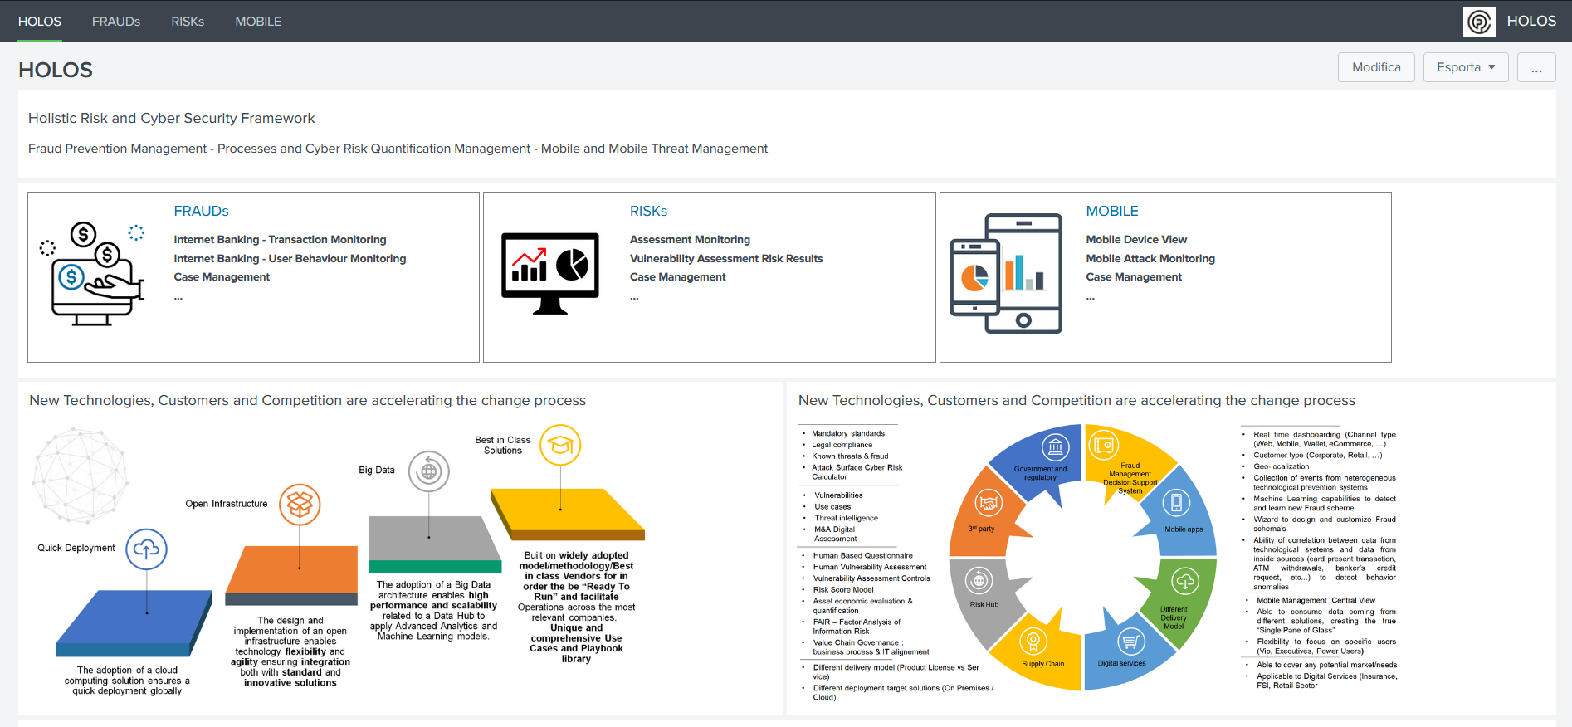
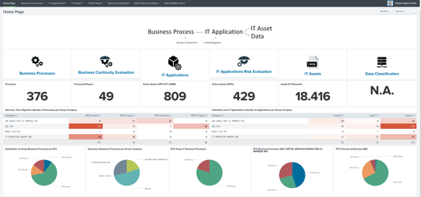
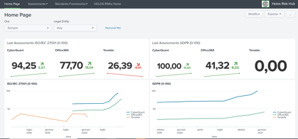
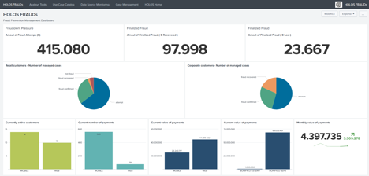
Idea
Requisites
Customers
Design
Development
Modeling
Analysis
Presentation Approach
High Level View
Specialized Modules

Slide 38
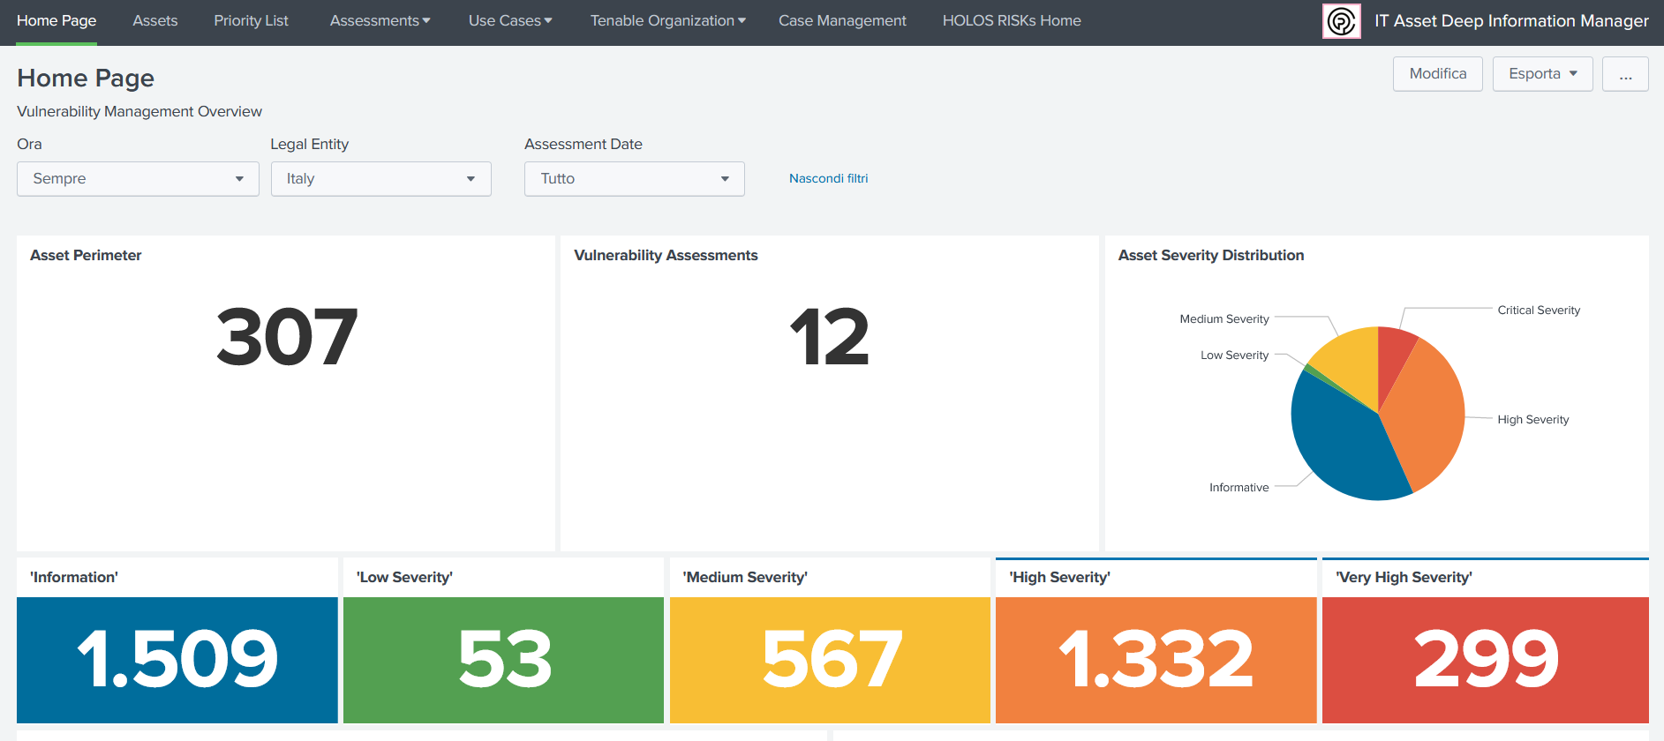
Idea
Requisites
Customers
Design
Development
Modeling
Analysis
Modules Presentation: Home page
Home Page

Slide 39
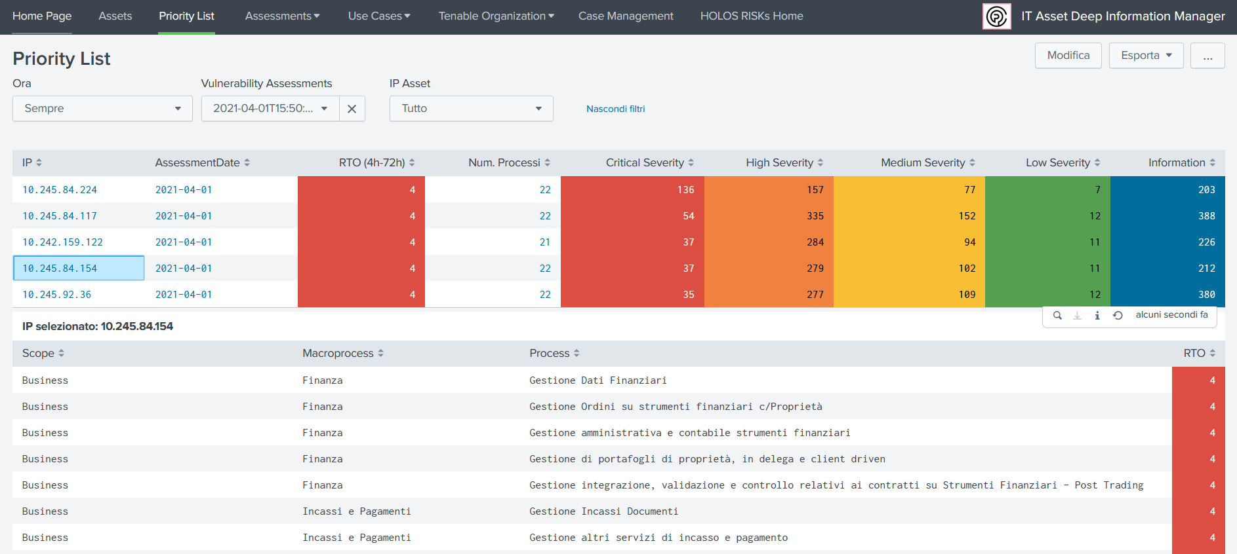
Idea
Requisites
Customers
Design
Development
Modeling
Analysis
Modules Presentation: Use Cases
Specific Use Cases: e.g. Priority List

Slide 40
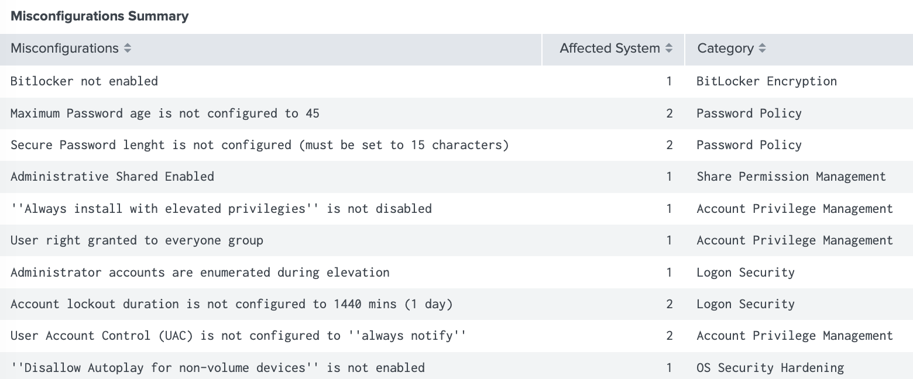
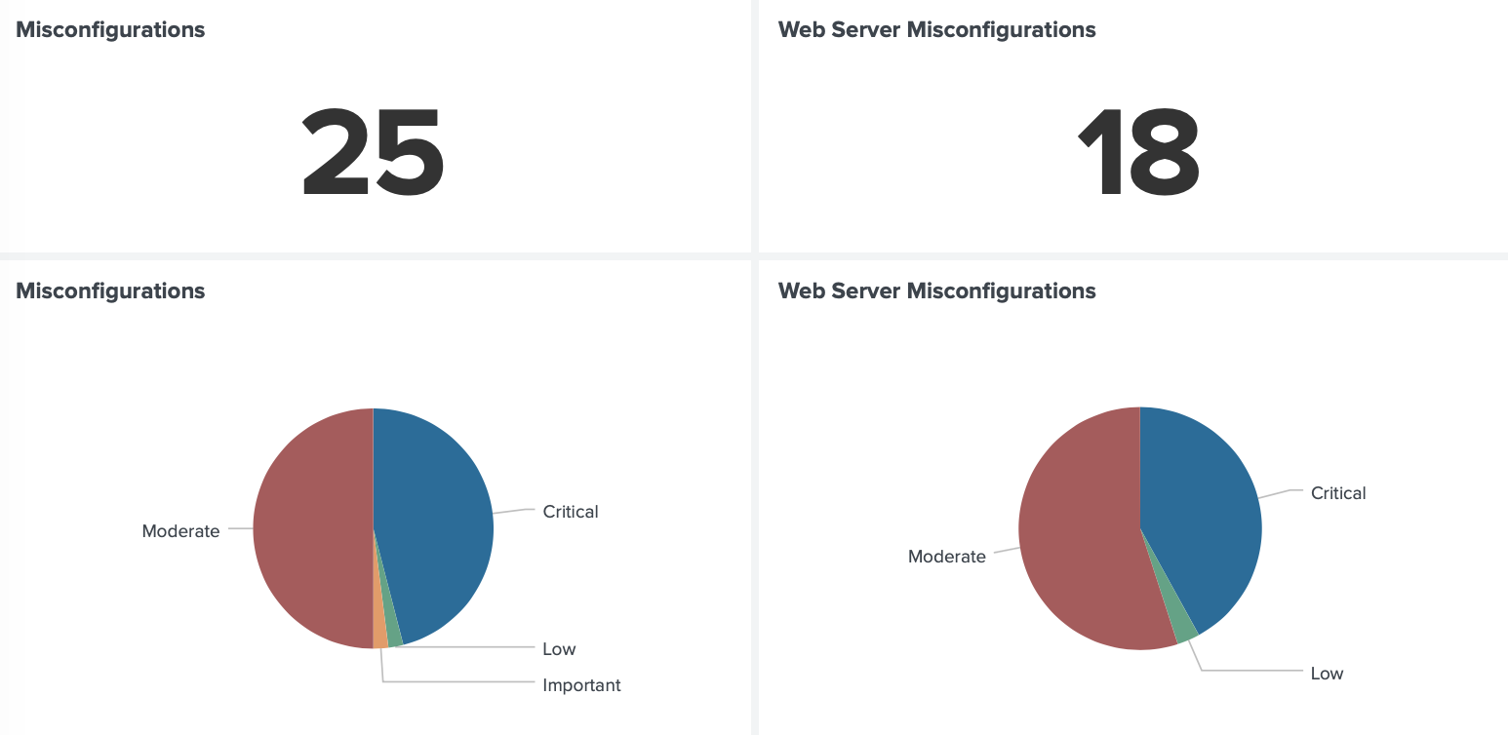
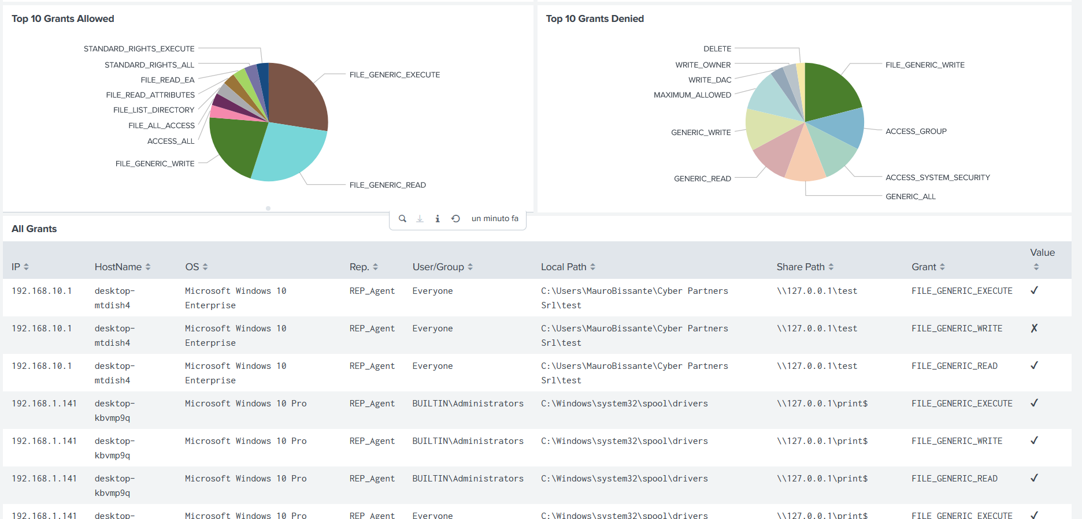
Idea
Requisites
Customers
Design
Development
Modeling
Analysis
Modules Presentation: Use Cases
Specific Use Cases: e.g. Shares monitoring

Slide 41
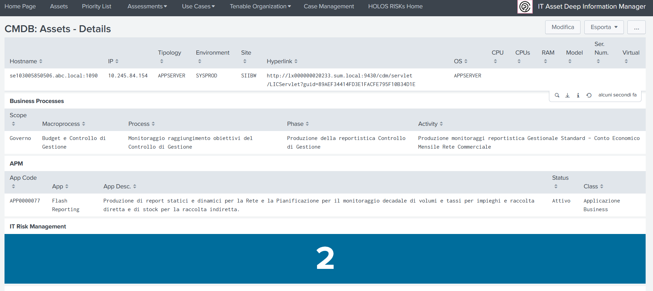
Idea
Requisites
Customers
Design
Development
Modeling
Analysis
Modules Presentation: Use Cases
Specific Use Cases: e.g. Assets Management

Slide 42

Idea
Requisites
Customers
Design
Development
Modeling
Analysis
Integration
Mobile Access
Case Manager
Dashboard & reporting
3° parts tools sharing
SOARs
SIEMs
Threat intelligence platforms (TIPs)

Slide 43
Demo: Use case 1: Security Asset management
43

Slide 44
Context:
An italian bank
Data from 5 not integrated systems
Taxonomy
Business Continuity
IT Risk
Application Portfolio Management
CMDB

Slide 45
Requirements:
Navigating data from an archive to another
Checking Data Quality
Highlighting non aligned or missing data between archives

Slide 46

The solution: Holos Risk Hub
Risk Hub
Value Chain
Data Controls
Case Manager
Live Demo
46

Slide 47
Demo: Use case 2: Risks
47

Slide 48
Context:
All the companies with Compliance requirements (ALL!)
Different and etherogeneous quantifications
from many involved systems: SIEMs, VAs, Cyber Risk Quantification tools, Cloud Service Providers, etc…

Slide 49
Requirements:
Access all the quantification results in one console
Compare values
Produce reporting aligned to standards (e.g. ISO27001) for auditors
Monitor and control risks

Slide 50
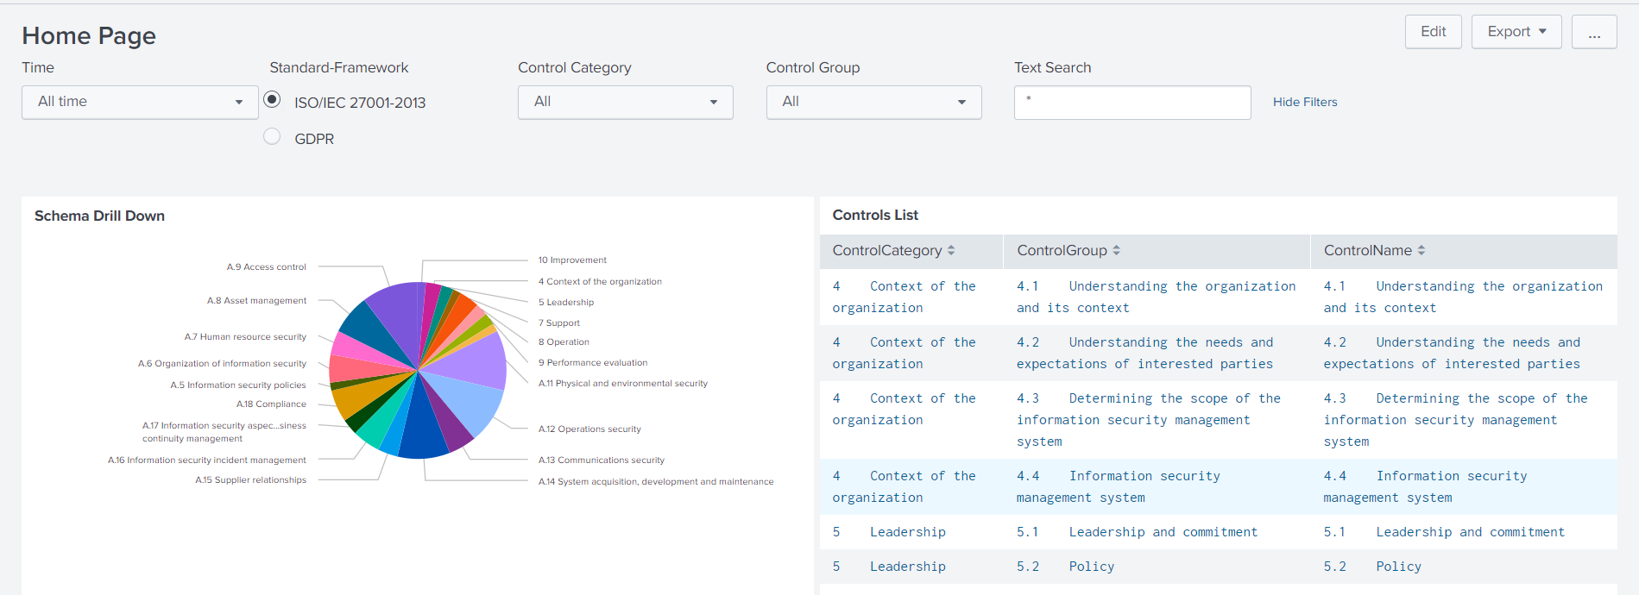
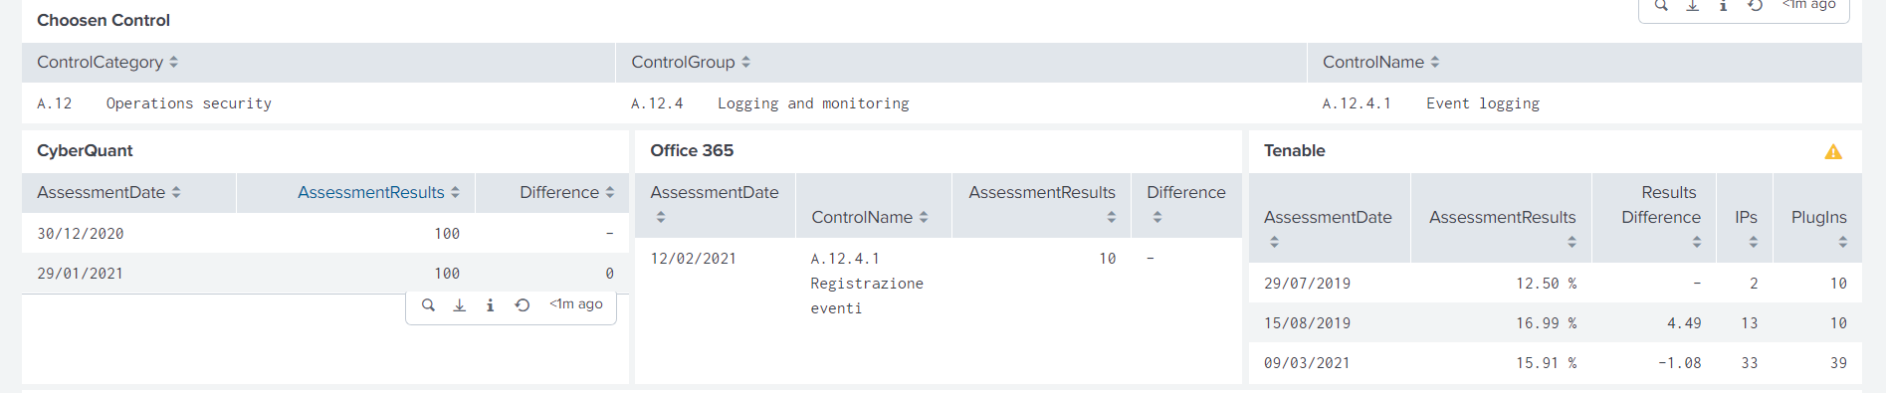
The solution: Holos Risks
Live Demo

Slide 51
Demo: Use case 3: Anti Fraud management
51

Slide 52
Context:
A multination bank in Italy
Interesting for banks, eCommerce and on line money transactions companies
All the company functions are included in the scope
There must be synergy among all the relevant company functions

Slide 53
Requirements:
To guarantee the governance of information concerning the phenomenon of on-line fraud in a multi-channel perspective
To establish a robust and reliable connection point for monitoring and reporting information on fraud detected and managed by the ecosystem of technologies in the field
To offer a single evaluation console on the impact of online fraud for the timely financial quantification of the fraud attempts suffered and any losses
To have a concrete aid capable of continuously contributing to the detection of the fraud risk

Slide 54
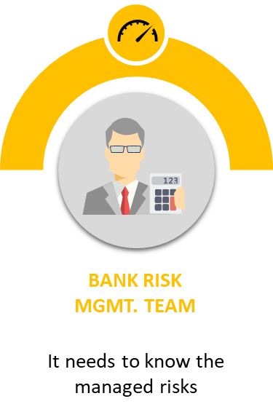
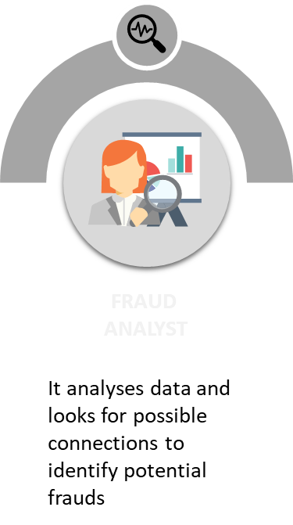
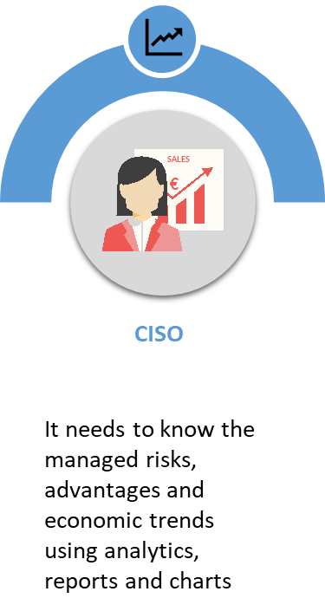
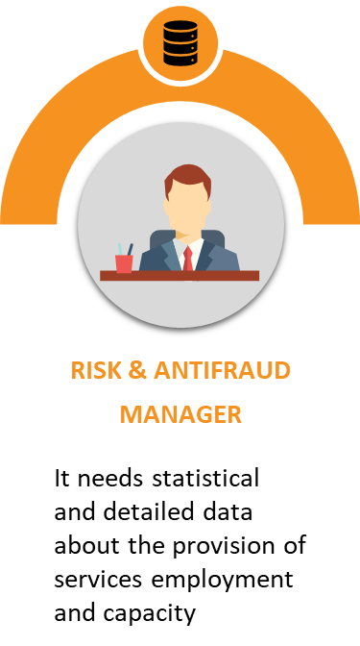

Receivers
With a single operative platform, Holos FP enables to manage, aggregate, analyse and show the information in a distinguished way for every different type of user

Slide 55
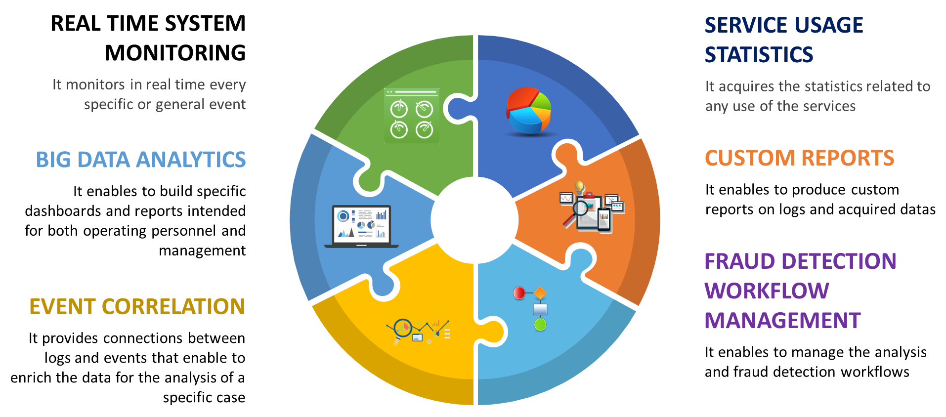
Main Freatures
Live Demo

Slide 56
Demo: Use case 4: M3 (Mobile Monitoring Management)
56

Slide 57
Context:
A large multinational company
Many mobile devices to manage and protect
Using in all the 5 continents

Slide 58
Requirements:
Access all the information (MDM and MTD) in one console
Produce reporting aligned to standards (e.g. ISO27001) for auditors

Slide 59
The solution: M3
HOLOS M³ represents the verticalization of the HOLOS platform for the mobile world; collects and correlates information and events from Device Management platforms, Secure Messaging Apps and Mobile Threat Defense solutions to provide a single monitoring and correlation console.
The main purpose is to provide:
HOLOS-M³ Mobile Monitoring & Management
An assessment of the state of compliance with policies and cyber risk of mobile devices;
Presentation of the actions performed on the devices divided by type;
Health status of the devices;
Visualization of the attacks suffered with presentation of the historical series

Slide 60
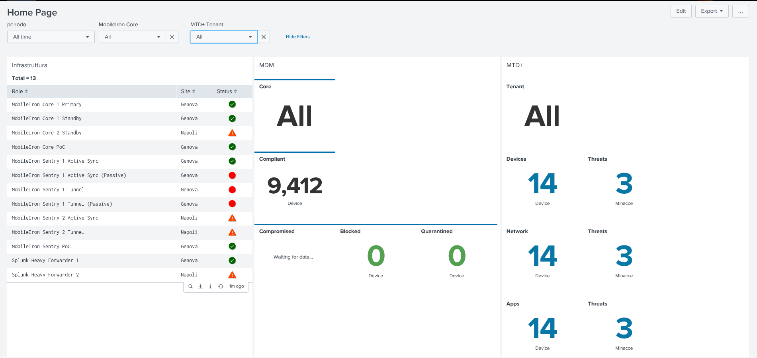
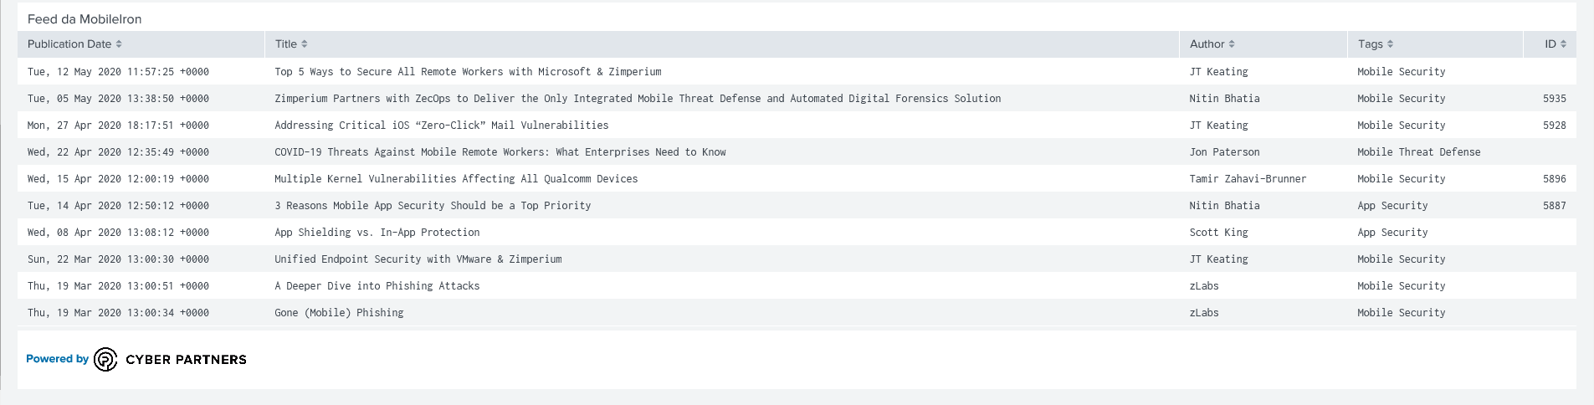
The solution: M3
Live Demo

Slide 61

Question Time!

Slide 62
THANKS!
gcusello
Giuseppe Cusello
Giuseppe.cusello@cyberpartners.it

